Slide 1
Predicting the most affecting parameters to Heart Disease
MSDS-530 Project
Submitted by: Dhiraj Bankar
GitHub location
https://github.com/dhirajbankar/ThinkStats2/tree/master/code/Final

Slide 2
Data to be Analyzed
Heart Disease UCI is dataset with 14 parameters
This project gives detailed analysis of below parameters
age: age
sex: sex
trestbps: resting blood pressure
chol: serum cholesterol in mg/dl
exang: exercise induced angina
oldpeak: ST depression induced by exercise relative to rest

Slide 3
Explanation of All Attributes
Column | Description
age | age in years
sex | (1 = male; 0 = female)
cp | chest pain type
trestbps | resting blood pressure (in mm Hg on admission to the hospital)
chol | serum cholestoral in mg/dl
fbs | (fasting blood sugar &gt; 120 mg/dl) (1 = true; 0 = false)
restecg | resting electrocardiographic results
thalach | maximum heart rate achieved
exang | exercise induced angina (1 = yes; 0 = no)
oldpeak | ST depression induced by exercise relative to rest

Slide 4
Histogram Plots for the selective variables

Slide 5
Histogram Plots for the selective variables

Slide 6
Histogram plots for blood pressure of Exercise person vs non exercise person

Slide 7
Summary & Analysis on Histograms
From the histograms, we may be able to see something but its not clearly visible
If you observe the histogram for Cholesterol for exercise vs non-exercise, it clearly gives bifurcation. The exercise person or active person has less cholesterol.
Similarly the blood press is less if person does the exercise.
As the histogram couldn’t give much information so lets move to next section.
We also see some outliers from the histograms, for old peak (Extra exercise in old age) which suggest things otherwise.
For now I let them in the dataset for further analysis, however if they have much effect on the prediction model, then we may try to resample the data. We can't do much removals in this dataset as the sample size is small and we don’t have enough samples to exclude or include.

Slide 8
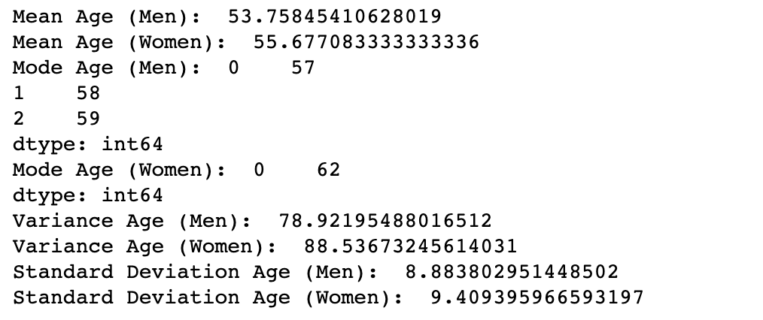
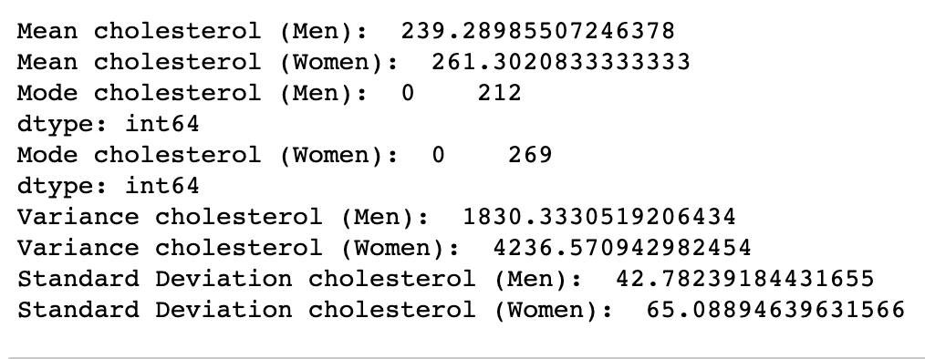
Other Descriptive Characteristics about the Variables in question

Slide 9
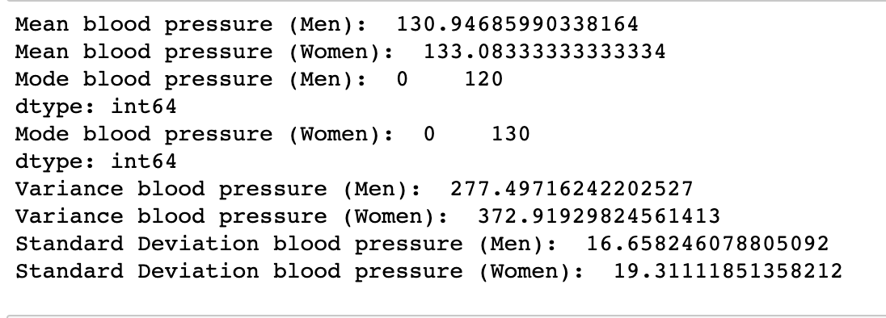
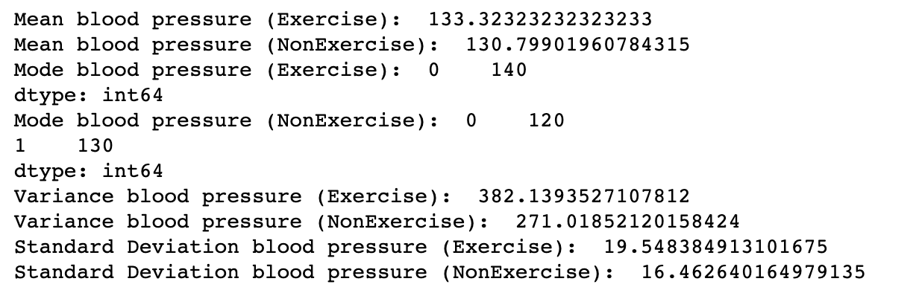

Slide 10
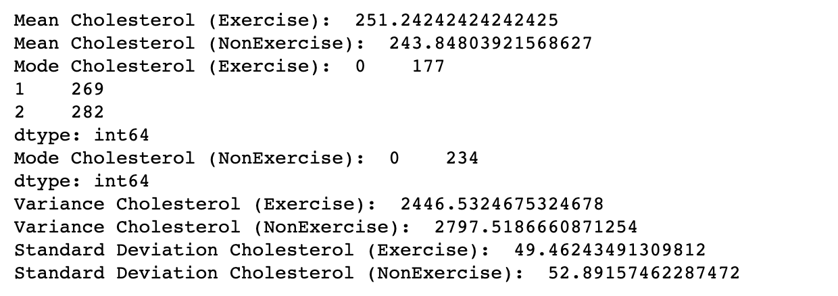

Slide 11
PMF – Blood pressure

Slide 12
PMF – Cholesterol

Slide 13
CDF Plot for Serum cholesterol in mg/dl for Men vs Women
From the CDF graph the
Most of men and women
cholesterol range
between 200 to 300

Slide 14
CDF Plot for blood pressure for Men vs Women

Slide 15
# Plotting only for women cholesterol, as it will give detailed insight on Heart disease
Data looks pretty good and well normalized.

Slide 16
Scatter Plots
From the scattered plot we can easy says there is very good correlation between variables.
If you observer the above correlations between variables. Age has 28% impact on blood pressure, 21 % on cholesterol. Aggressive exercise in old age impacts a 19% on Blood pressure and finally there cholesterol and blood pressure are 12% related.
All other variables (cholesterol vs sex)has very less correlation values or -ve values so I ignored them.

Slide 17
Hypothesis Test – Using Mean difference

Slide 18
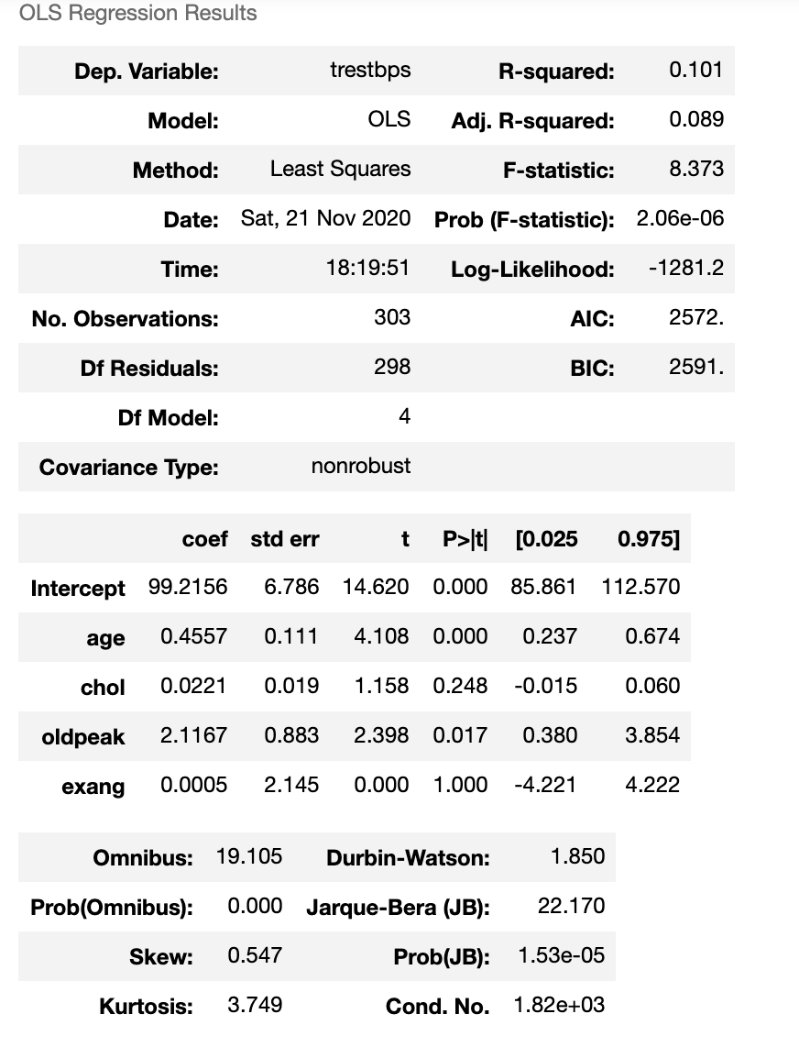
Nonlinear Regression Model for the dataset
From The above result the P>|t| for age ,
oldpeak, chol is very low so we can
say that the most affecting parameter
to the blood pressure are age, extra
exercise in ole age and cholesterol.

Slide 19
References
GitHub location
https://github.com/dhirajbankar/ThinkStats2/tree/master/code/Final
Think Stats, Allen B Downey
https://www.kaggle.com/ronitf/heart-disease-uci
Authors of this Dataset
Hungarian Institute of Cardiology. Budapest: Andras Janosi, M.D.
University Hospital, Zurich, Switzerland: William Steinbrunn, M.D.
University Hospital, Basel, Switzerland: Matthias Pfisterer, M.D.
V.A. Medical Center, Long Beach and Cleveland Clinic Foundation: Robert Detrano, M.D., Ph.D.

